Slide 1

STRATEGIC MANAGEMENT AND LEADERSHIP
Strategic Management Demystified

Slide 2
What is strategy?
Strategy is a tactical course of action which is designed to achieve long term objectives. It is an art and science of planning and marshalling resources for their most efficient and effective use in a changing environment.
Strategy of a business enterprise consists of what management decides about the future direction and scope of the business. It entails managerial choice among alternative action programmes, competitive moves and different business approaches to achieve enterprise objectives.
Strategy once formulated has long term implications. It is framed by top management in an organization. In short, it may be called as the ‘game plan of management’.

Slide 3
Definition of Strategy
As per Glueck,
Strategy is unified, comprehensive and integrated plan relating the strategic advantages of the firm to the challenges of the environment. It is designed to ensure that the basic objectives of the enterprise are achieved.
As per Alfred D. Chandler,
Strategy is “The determination of basic long-term goals and objectives of an enterprise and the adoption of the courses of action and the allocation of resources necessary for carrying out these goals.”

Slide 4
Features of Strategy
Top management responsibility
Allocation of large amount of resources
Impact on long term prosperity of the firm
Future oriented
Multi-functional or multi-business consequences
Consideration of factors in the external environment

Slide 5
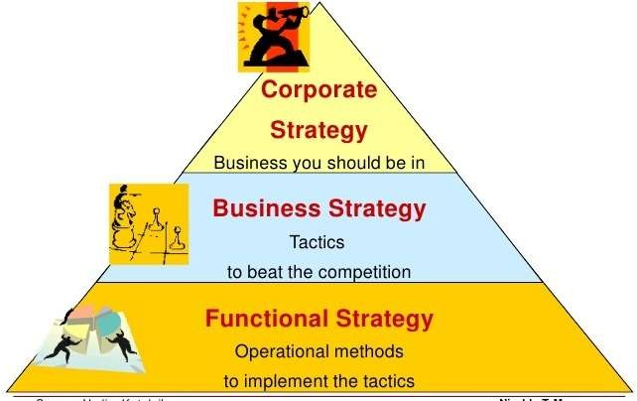
Levels of Strategy

Slide 6
Corporate-level Strategy
At this level, strategic decisions relate to organization-wide policies and are taken care by top-level management (BOD) with a vision of determining ‘Where the company wants to be?’
It has two main aspects- Formulation of Strategy (strategic planning) and Strategy Implementation
The nature of strategy at this level tend to be value-oriented, conceptual and than other levels.
There is also greater risk, cost and profit potential as well as greater need of flexibility associated with this level.
Major financial policy decisions involving acquisition, diversification and structural redesigning belong to this level.

Slide 7
Business-Level Strategy
Business-level strategy is more likely related to a unit within the whole. It is concerned with competition in a market.
The concerns are about what products or services should be developed and offered to which markets in order to meet customer needs and organizational objectives.
At this level, multifunctional strategies developed at corporate level are formulated and implemented for specific product market in which the business operates. Thus, managers at this level translate general directions and intent into concrete functional objectives.
Decisions at this level include policies involving new product development, marketing mix, research & development, personnel, etc.

Slide 8
Functional/Operational-Level Strategy
Functional strategy involves decision-making with respect to specific functional areas- production, marketing, personnel, finance etc.
While corporate and business level strategies are concerned with “Doing the right things”, functional strategies stress on “Doing things right”.
Operating level strategy is concerned with strategic approaches for managing frontline operating units(like plants, sales, etc) and for handling day to day tasks of strategic significance(like advertising campaign, purchasing materials, inventory control, maintenance, etc.). Thus, it focuses on how the different functions of the enterprise contribute to the other levels of strategy.
Thus, functional level strategic management is the management of relatively narrow areas of activity, which are of vital, pervasive or continuing importance to the total organization.

Slide 9
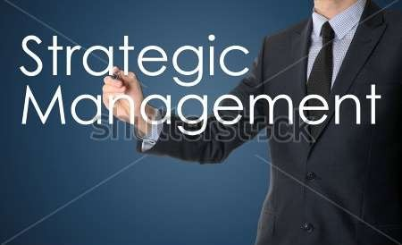

Slide 10
Strategic Management
Strategic management is a set of management decisions and actions that determines the long-run performance of a corporation. It includes environmental scanning, strategy formulation, strategy implementation and evaluation and control to achieve the objectives of an organization.
The study of strategic management emphasizes the monitoring and evaluating of external opportunities and threats in light of a corporation’s strengths and weaknesses.

Slide 11
As per Fred R. David, strategic management is an art and science of formulating, implementing and evaluating cross functional decisions that enable an organization to achieve its objectives.
As per Channon, strategic management is defined as that set of decisions and actions that result in formulating of strategy and its implementation to achieve the objectives of the corporation.

Slide 12
Levels of Strategic Management
Here are four different levels of strategic management
Level 1 — Articulated Plan: The plan has established the mission, vision, goals, actions, and key performance indicators (KPIs) for the next 24 to 36 months.
Level 2 — Strategic Differentiation: The plan has a strategic focus on delivering a unique value proposition developed from a clear understanding of market position and customer needs.

Slide 13
CONT.
Level 3 — Organizational Engagement: Everyone knows the strategic direction, understands his role, and commits to accountability. An execution/governance process is in place.
Level 4 — Organizational Transformation: High-performing team, driven by shared values, consistently drives decision making based on the agreed-upon strategy with data, structure (organizational and process), and systems in place to support the activity.

Slide 14
Benefits of Strategic Management
There are many benefits of strategic management and they include:-
Identification, prioritization, and exploration of opportunities.
Discharges Responsibility
Allows an Objective Assessment
Provides a Framework for Decision-Making
Enables Understanding & Buy-In
Facilitates Measurement of Progress
Affords an Organizational Perspective of Competing Components
Enhances Strategic Agility (Innovation)

Slide 15
Limitations of Strategic Management
The Future Rarely Unfolds As Anticipated.
Return on Investment
May Impede Agility
Long Term Benefit vs. Immediate Results
Closing Thoughts

Slide 16
Business Model

Slide 17
a business model describes the value an organization offers to various customers and portrays the capabilities and partners required for creating, marketing, and delivering this value and relationship capital with the goal of generating profitable and sustainable revenue streams

Slide 18
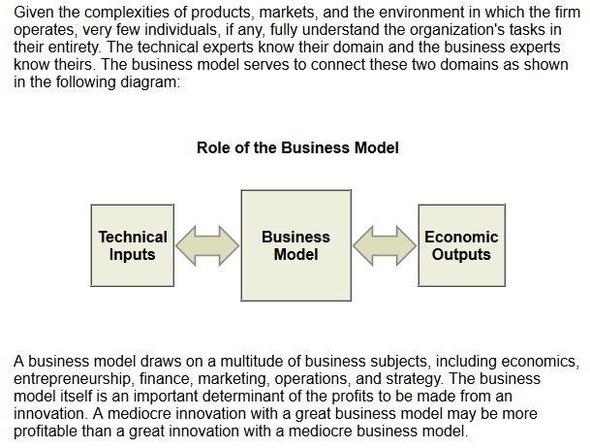

Slide 19
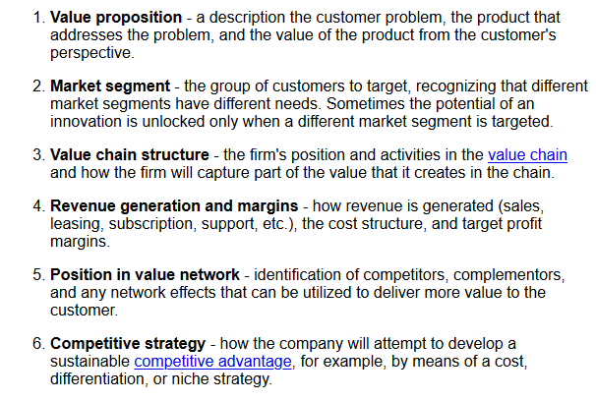
COMPONENTS OF A BUSINESS MODEL

Slide 20
5 forces
customer needs
technological change
BUSINESS MODEL
legal environment
social environment
competition

Slide 21
STRATEGY
BUSINESS MODEL
ORGANIZATION
TECHNOLOGY
the business model’s place in the company

Slide 22
Competitive Advantage
G2

Slide 23




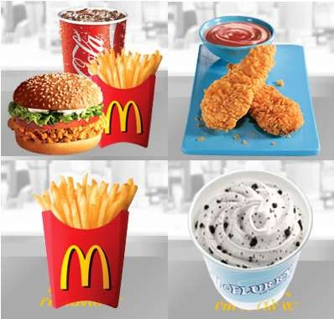

Competitive Advantage means
Something that places a company
or a person above the competition

Slide 24
The company will be able to apply to strong point
Without being what does not evaluate a property and the ability which the company possesses
Competition company comparison will lead and the strong point which is relative could be grasped.
The strategy which sees from viewpoint of competitive advantage
Continuous a competitive advantage reinforcement and competitive advantage endeavors not to disappear

Slide 25
The reason of enterprise have a competitive advantage
Resource/Performance
Customer satisfaction and loyalty increase, Increase of profit
, Increase of market share
→ bring market perfomance
The product offering which is value in the market
→ competitive advantage offering valuable product and service
various size and scope and profitability of company
→ The competitive advantage makes the base will be able to expan
d the enterprise which is various.

Slide 26
Competitive Advantage Cycle.
Step 1. Source of Competitive Advantage
Superior assets Super Capabilities Key Success Factor
STEP4. Encroachment
STEP3. Value proprsal
Step 2. Barriers to Imitation
STEP2. Barrier to Imitation
higher the barrier to entry to company When the new business opportunity coming from the Market which enters
first mover advantage
barriers to imitation
STEP1. Source of Competitive Advantages.

Slide 27
Step 3. Value proposal form of competitive advantage
Operational Excellence Product Leadership Customer Intimacy
Step 4.Eencroachment prevents of competitive advantage
New competitive advantage position construction
effort encroachment prevents of competitive advantage Reinvestment of profit
asset and capability accumulation resource strengthen of competitive advantage

Slide 28
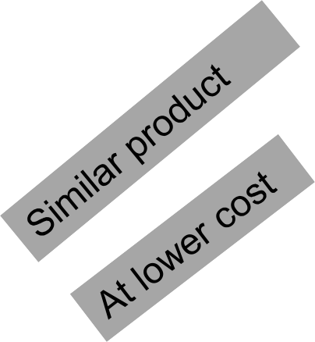

Cost advantage
Competitive Advantage
Differentiation
Advantage

Slide 29
A Model of Competitive advantage
Resources
Cost advantage Or
Differentiation advantage
Distinctive
Competencies
Value
Creation
Capabilities

Slide 30
Main aspects of five forces analysis
the rivalry between existing sellers in the market
the potential threat of the entry of new competitors
the threat of substitute products becoming available the market
the bargaining power of consumer
the bargaining power of suppliers

Slide 31
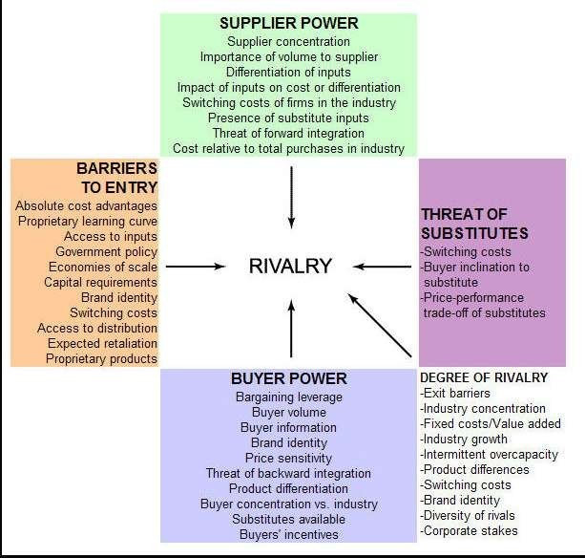
Main aspects of five forces analysis

Slide 32
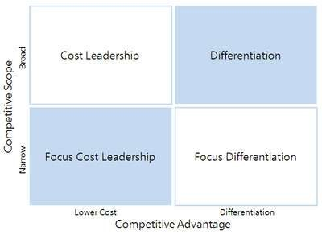
Competitive advantage
strategies

Slide 33
1. Cost Leadership (Low Cost Strategy)
cost Leadership mean that produce goods level of equal more in expensive
differentiation (Differentiation Strategy)
Differentiation is that provide inventive value can improve of perceive valued of consumers toward product(or service) in the market.
Focus Cost Leadership / Differentiation:
When competition's range is narrow, in other words when target on specific customer segment will be focused cheap price and differentiation strategy.

Slide 34

Source of Global competitive advantage
Adapting to local market differences | Exploiting economies of global scale | Exploiting economies of global scope | Tapping the optimal locations for activities and resources | Maximizing knowledge transfer across location

Slide 35
Adapting to Local Market Differences
Companies must respond to the inevitable heterogeneity they will encounter in these markets.
Differences in language, culture, income levels, customer preferences, and distribution systems.
(a) Increased market share.
(b) Improved
price realization.
(c) Neutralizing local competitors.
Adapting to local market differences

Slide 36
(a) Increased market share.
Offering standard products and services across countries reduces the boundaries of the served market to only those customers whose needs are uniform across countries.
(b) Improved price realization.
Tailoring products and services to the preferences of local customers enhances the value delivered to them.
A portion of this increased value should translate into higher
price realization for the firm

Slide 37
© Neutralizing local competitors.
One of the natural advantages enjoyed by most local competitors stems from their deep understanding of and single-minded responsiveness to the needs of the local market.

Slide 38
Questions?

Slide 39


